Slide 1
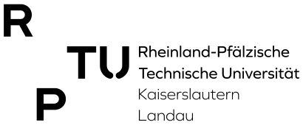
Efficient Object Tracking For Autonomous Driving
Dheeraj Varma Chittari
Master’s Thesis in Informatics: Artificial Intelligence
Supervisor: Prof.Dr.H.C. Andreas Dengel
Advisor: Abdul Hannan Khan, M.Sc.
Rheinland Pfälzische Technische Universität - Kaiserslautern Landau
1
Dheeraj Master’s Thesis on Object Tracking

Slide 2
Contents
Overview of Autonomous Driving
Planning Module
Object Tracking
CenterTrack Tracker
Objective
CenterTrack Characteristics
CenterTrack Architecture
CenterTrack Baseline Setup
Experiments
Impact of Feature Extractors on Object Tracking
Introduction of Attention through Mixers
Leveraging Unmatched Detections and Unused Tracklets
Conclusion
Dheeraj Master’s Thesis on Object Tracking

Slide 3
High Level Overview of Autonomous Driving
Autonomous Driving Systems: Perception, Planning, and Control
Perception module: contains sensors and perceives information about the surrounding environment.
Planning module : Processes the sensor information and produces a collision-free trajectory.
Control module : Executes the trajectory produced by the planner module.
Perception
Planning
Control
Fig 1: Autonomous Driving Modules
3
Dheeraj Master’s Thesis on Object Tracking

Slide 4
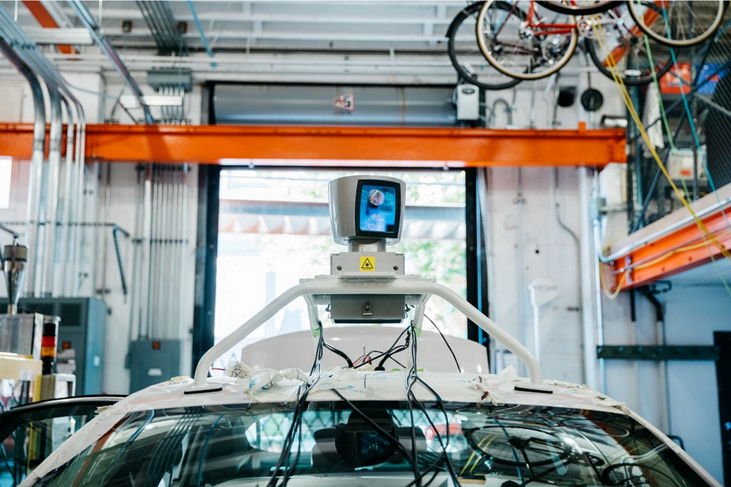
Autonomous Driving - Planning Module
Planning module has two components:
Occupancy Maps: Responsible for finding the optimal route from point A to B.
Motion Estimation: Predicts the next state that the ego vehicle should follow. Employs computer vision based Object Tracking techniques.
Ego Vehicle:
Autonomous vehicle equipped with sensors.
Perception
Planning
Control
Occupancy Maps
Motion Estimate
Fig 2: Autonomous Driving Modules with expanded planning.
Fig 3:Ego vehicle [1].
4
Dheeraj Master’s Thesis on Object Tracking

Slide 5
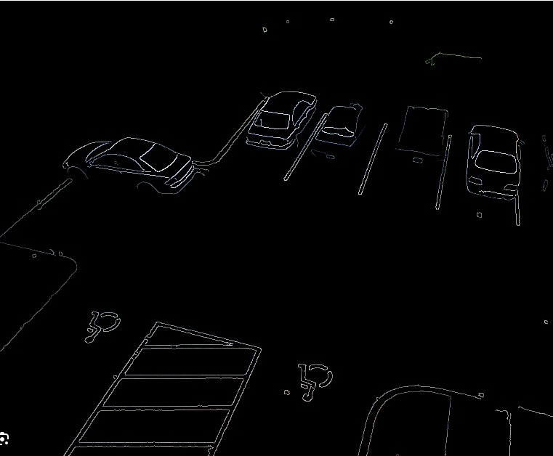
Object Tracking
Identifying the objects of interest and track them over time.
Traditional Computer Vision based Object Tracking
Feature Extraction: SIFT or Canny Edge techniques and masking the background.
Feature Tracking: Kalman or Particle filter methods.
Advantages
Does not require extensive training data not training time, better interpretability.
Downsides
Sensitive to the changes in brightness, partial occlusion, abrupt motion and direction changes.
Fig 4: Canny edge detection on cars and road [2].
5
Dheeraj Master’s Thesis on Object Tracking

Slide 6
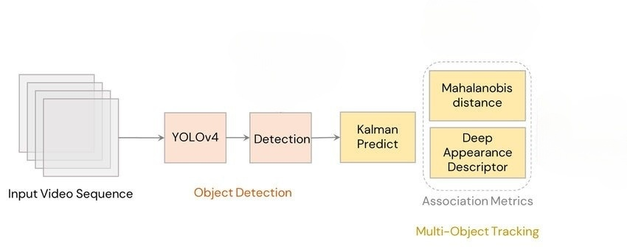
Object Tracking Continue
Deep Learning based object tracking has two stages
Object Detection: Pretrained object detectors for feature extraction.
Motion and Appearance Modelling: Estimating the next state of an object.
Better handle changes in brightness, partial occlusion and motion blur that lead to a higher tracking accuracy.
As these advantages outweighs downsides of traditional methods, we considered using deep learning approaches for our experiments.
Fig 5: General overview of Deep Learning based Object Tracker Algorithm [3].
6
Dheeraj Master’s Thesis on Object Tracking

Slide 7
Contents
Overview of Autonomous Driving
Planning Module
Object Tracking
CenterTrack Tracker
Objective
CenterTrack Characteristics
CenterTrack Architecture
CenterTrack Baseline Setup
Experiments
Impact of Feature Extractors on Object Tracking
Introduction of Attention through Mixers
Leveraging Unmatched Detections and Unused Tracklets
Conclusion
7
Dheeraj Master’s Thesis on Object Tracking

Slide 8
Objective
Analyse the impact of various components of Deep Learning based Object Tracker.
With the main motivation of improving the effectiveness of the object tracking accuracy and latency.
Input images
Backbone
Neck
Head
Tracker Module
Tracks
Object Detector Module
Fig 6: Various modules of deep learning based object tracker.
8
Dheeraj Master’s Thesis on Object Tracking

Slide 9
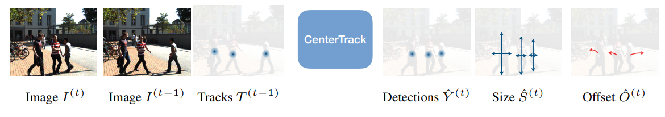
CenterTrack Object Tracker
Point-based Object Tracker
Representing objects as points rather than bounding boxes.
Optical Flow Modelling
Incorporates optical flow estimation network.
Single Network Architecture
All the tasks, object center estimation, size regression, and optical flow estimation, are achieved within a single network architecture.
Low Latency and Competitive Performance
Achieves competitive results leveraging object features extracted from both previous & current frames.
Fig 7: CenterTrack Object Tracker [4].
9
Dheeraj Master’s Thesis on Object Tracking

Slide 10
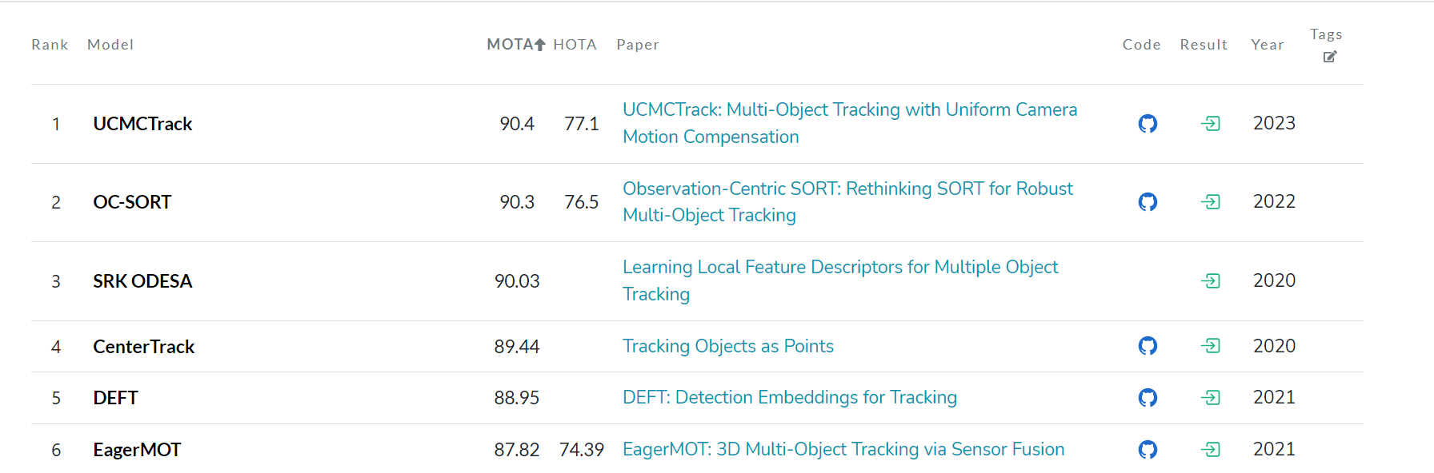
Reasons For Choosing CenterTrack
Leading Object Tracker:
CenterTrack excels in multi-object tracking, especially for autonomous driving.
Low Latency:
Real-time adoption.
Unique Methodology:
Considers object center points for tracking.
Estimates the Motion model through the DL network.
Considers the previous image features.
Open-Source Project:
As an active open-source project on GitHub.
Allows customization and integration.
Fig 8: Performance leaderboard on Multi-Object KITTI Tracking dataset [5].
10
Dheeraj Master’s Thesis on Object Tracking

Slide 11
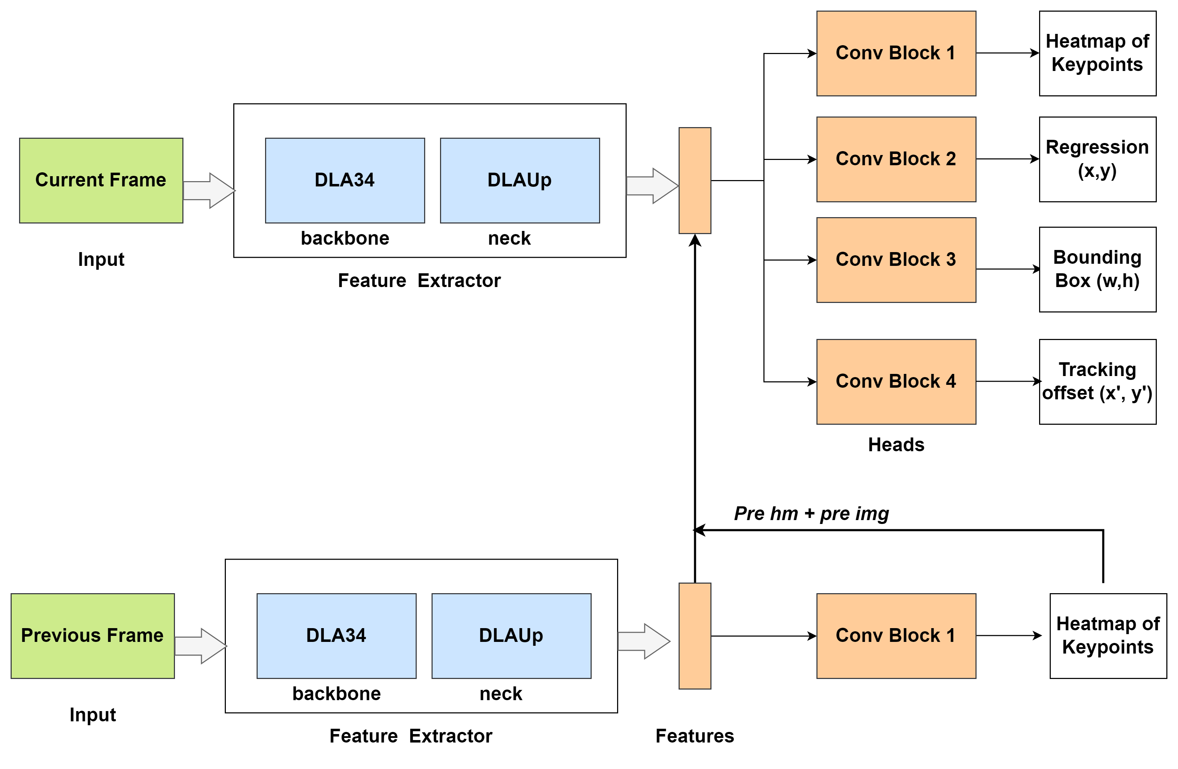
CenterTrack Architecture
Input:
Images or videos as input.
Backbone Network:
Utilizes Deep Layer Aggregation (DLA34) for feature extraction.
Neck Network:
Deep Layer Aggregation (DLAUp) refines features through upsampling and downsampling layers.
Head Network:
Consists of conv blocks to predict the final outputs.
Track Association:
Connects the tracks among object in two frames using the learned offsets.
Feature Augmentation:
Incorporates features from the previous image and object heatmap to provide rich information.
Fig 9: CenterTrack Architecture.
11
Dheeraj Master’s Thesis on Object Tracking

Slide 12
CenterTrack Baseline Setup
Baseline Model:
CenterTrack original model is pretrained on Nuscenes dataset and finetuned on KITTI Tracking dataset.
Our baseline model is using only KITTI training dataset as training on Nuscenes is taking approximately 7-10 days.
CenterTrack original model has MOTA of 89.4 but our baseline model has an accuracy of 83.02 MOTA.
All our experiments are compared to our baseline results.
Accuracy Metrics:
False Positives: Tracking the wrong object.
False Negative: Failing to track the correct object.
IDSW: Tracking an object with wrong identity, identity belongs to a different object.
MOTA = 1 – [ ( FP + FN + IDSW ) / GT ]
Model Efficiency Metrics:
FLOPS: Floating point operations required to process one image (input).
Model Size: Determined by the total number of parameters.
Inference Time : Time taken to infer results for a single image (input).
12
Dheeraj Master’s Thesis on Object Tracking

Slide 13
Contents
Overview of Autonomous Driving
Planning Module
Object Tracking
CenterTrack Tracker
Objective
CenterTrack Characteristics
CenterTrack Architecture
CenterTrack Baseline Setup
Experiments
Impact of Feature Extractors on Object Tracking
Introduction of Attention through Mixers
Leveraging Unmatched Detections and Unused Tracklets
Conclusion
13
Dheeraj Master’s Thesis on Object Tracking

Slide 14
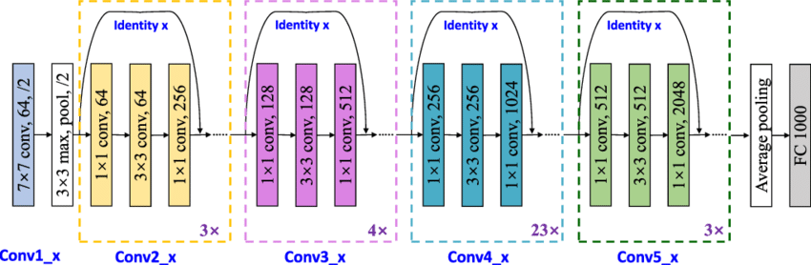
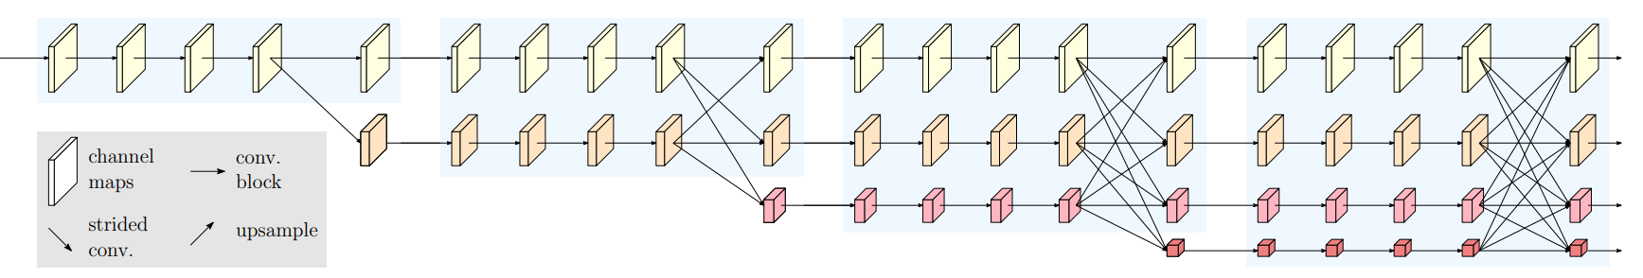
Analysing the Impact of Feature Extractors on Tracking
CenterTrack uses Deep Layer Aggression (DLA34) as a feature extractor.
Resnet101 Backbone: More Deeper Network.
High Resolution Network (HRNet): Aggregates image features from different scales. Pose Estimation.
Fig 11: Resnet101 block diagram [7].
Fig 12: HRNet backbone block diagram [8].
14
Dheeraj Master’s Thesis on Object Tracking

Slide 15
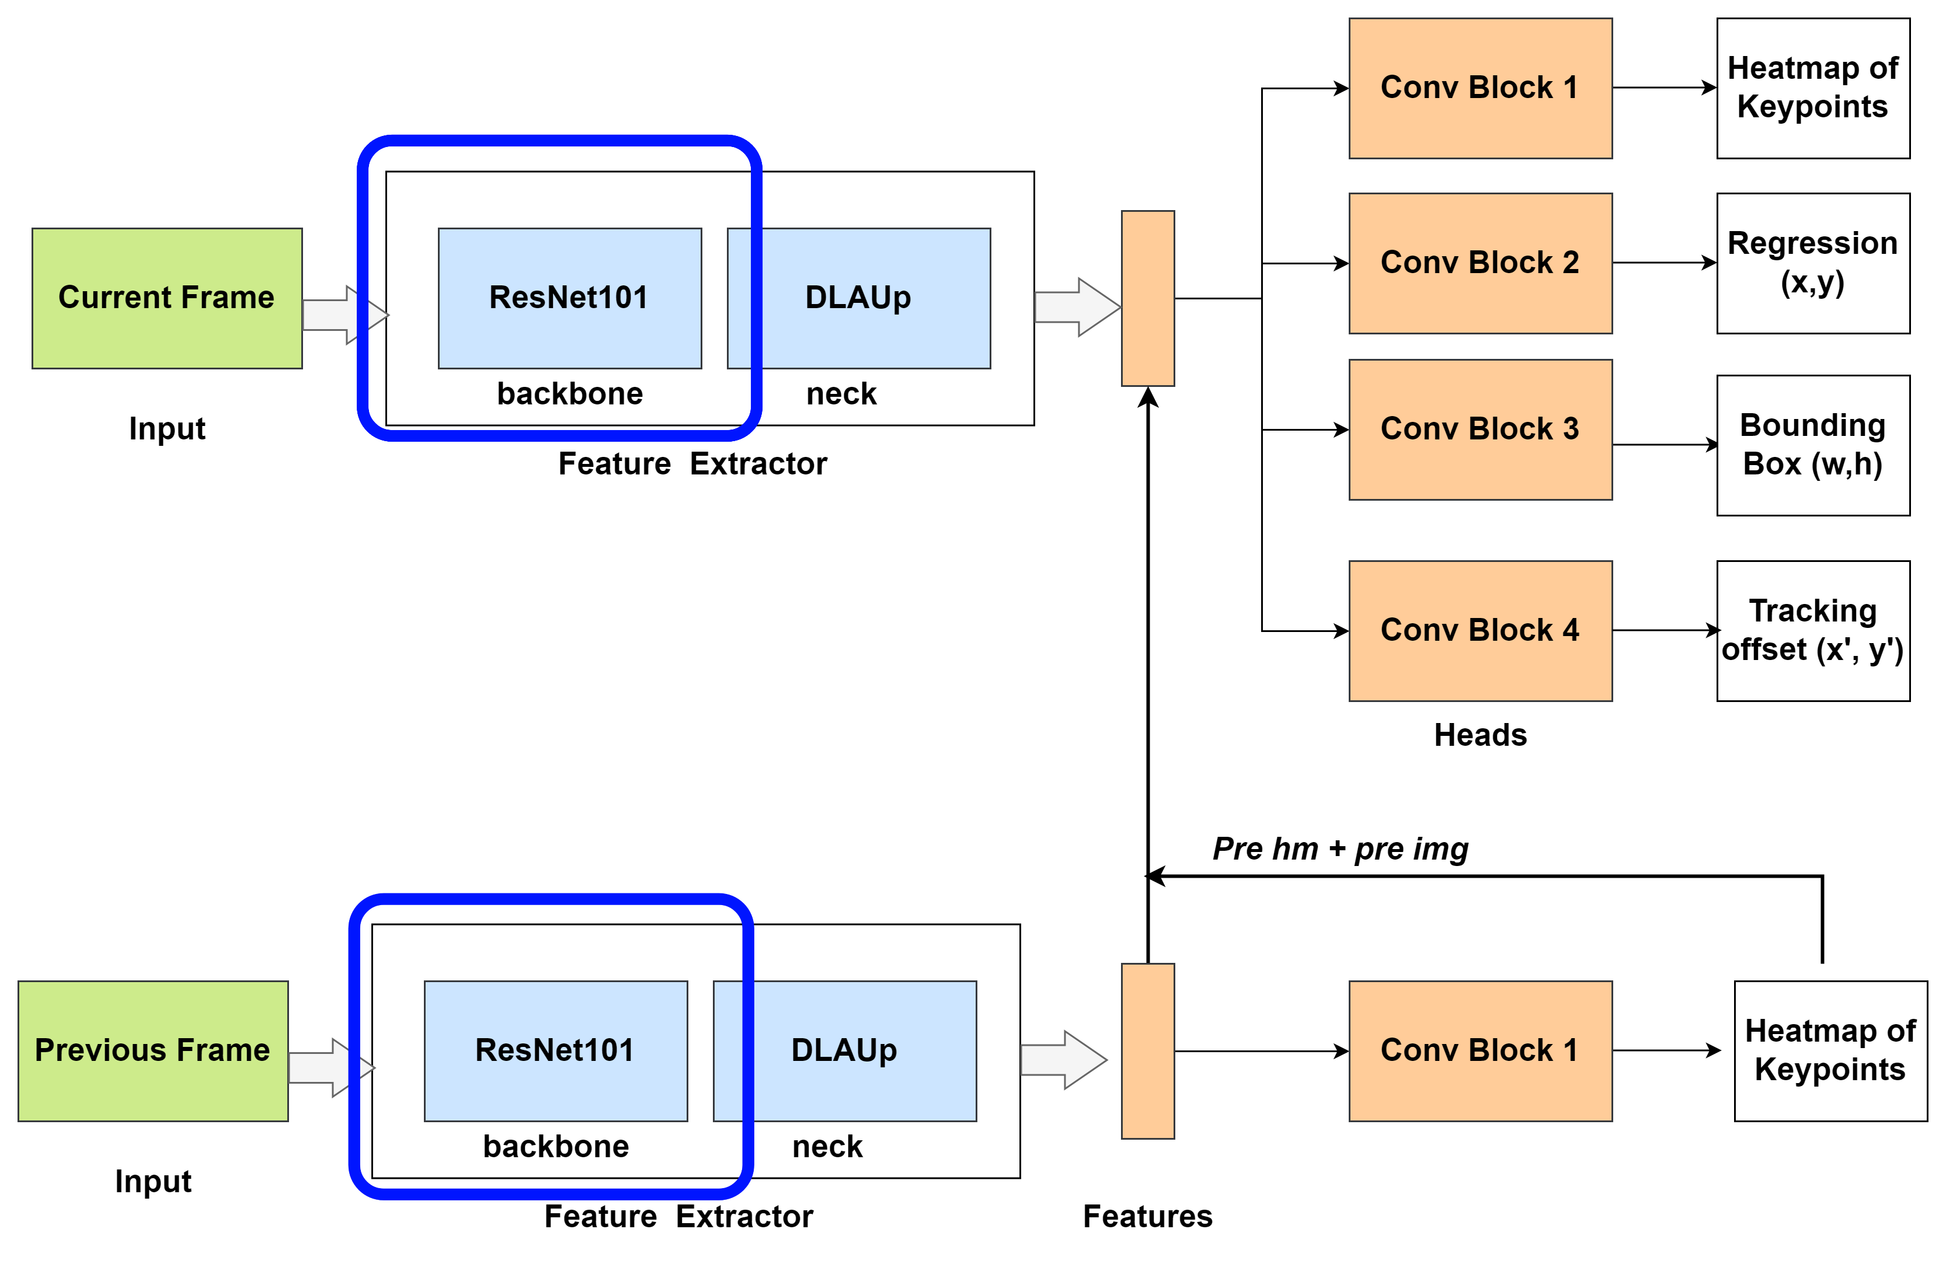
Analysing the Impact of Feature Extractors on Tracking
Replaced the DLA34 backbone with Resnet-101.
Fig 13: CenterTrack Architecture with Resnet101 backbone.
15
Dheeraj Master’s Thesis on Object Tracking

Slide 16

Analysing the Impact of Feature Extractors on Tracking
Replaced the DLA34 backbone with HRNet backbone.
Fig:14 CenterTrack Architecture with HRNet backbone.
16
Dheeraj Master’s Thesis on Object Tracking

Slide 17
Analysing the Impact of Feature Extractors on Tracking
Conclusion
Reason for under performance:
Backbone and Neck networks are complement to each other.
DLA34 itself has multiple iterative and hierarchical connections.
Feature Extractors | Class | MOTA (↑) | FP (↓) | FN (↓) | IDSW(↓)
DLA Backbone | Car Pedestrian | 83.02 61.49 | 933 397 | 906 1317 | 23 13
Resnet101 | Car Pedestrian | 66.38 40.93 | 686 248 | 2805 2354 | 197 47
HRNet | Car Pedestrian | 74.8 53.4 | 931 187 | 1660 1845 | 166 58
Feature Extractors | FLOPS (↓) | Model Size (↓) | Infer Time (↓)
DLA Backbone | 105.56 G | 19.91 M | 28.4 ms
Resnet101 | 224.63 G | 98.22 M | 52.7 ms
HRNet | 164.15 G | 30.53 M | 44.6 ms
Table 3: Efficiency evaluation of CenterTrack with various Backbone.
Table 2: Tracking accuracy comparison of CenterTrack with various Backbone.
17
Dheeraj Master’s Thesis on Object Tracking

Slide 18
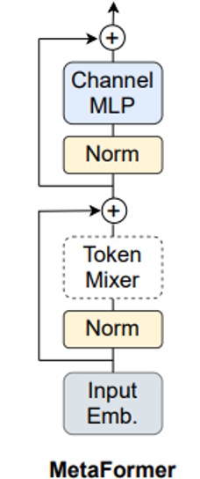
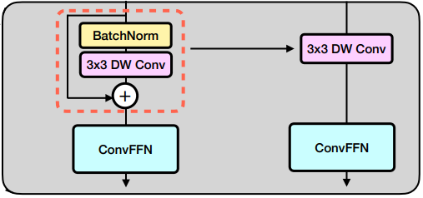
Introducing Attention through Mixers in the Head Network
Approximate the Attention with MLPs
Token and channel mixers as presented by MetaFormer.
Reparametrize Mixers (RepMixer)
Token Mixer : Depthwise Convolution
Applies a single convolutional filter per input channel
Channel Mixer: ConvFFN
Combination of pointwise convolutions and Feedforward Network.
Fig:15 MetaFormer Architecture [9].
Train
Test
Fig:16 RepMixer Architecture [10].
18
Dheeraj Master’s Thesis on Object Tracking

Slide 19
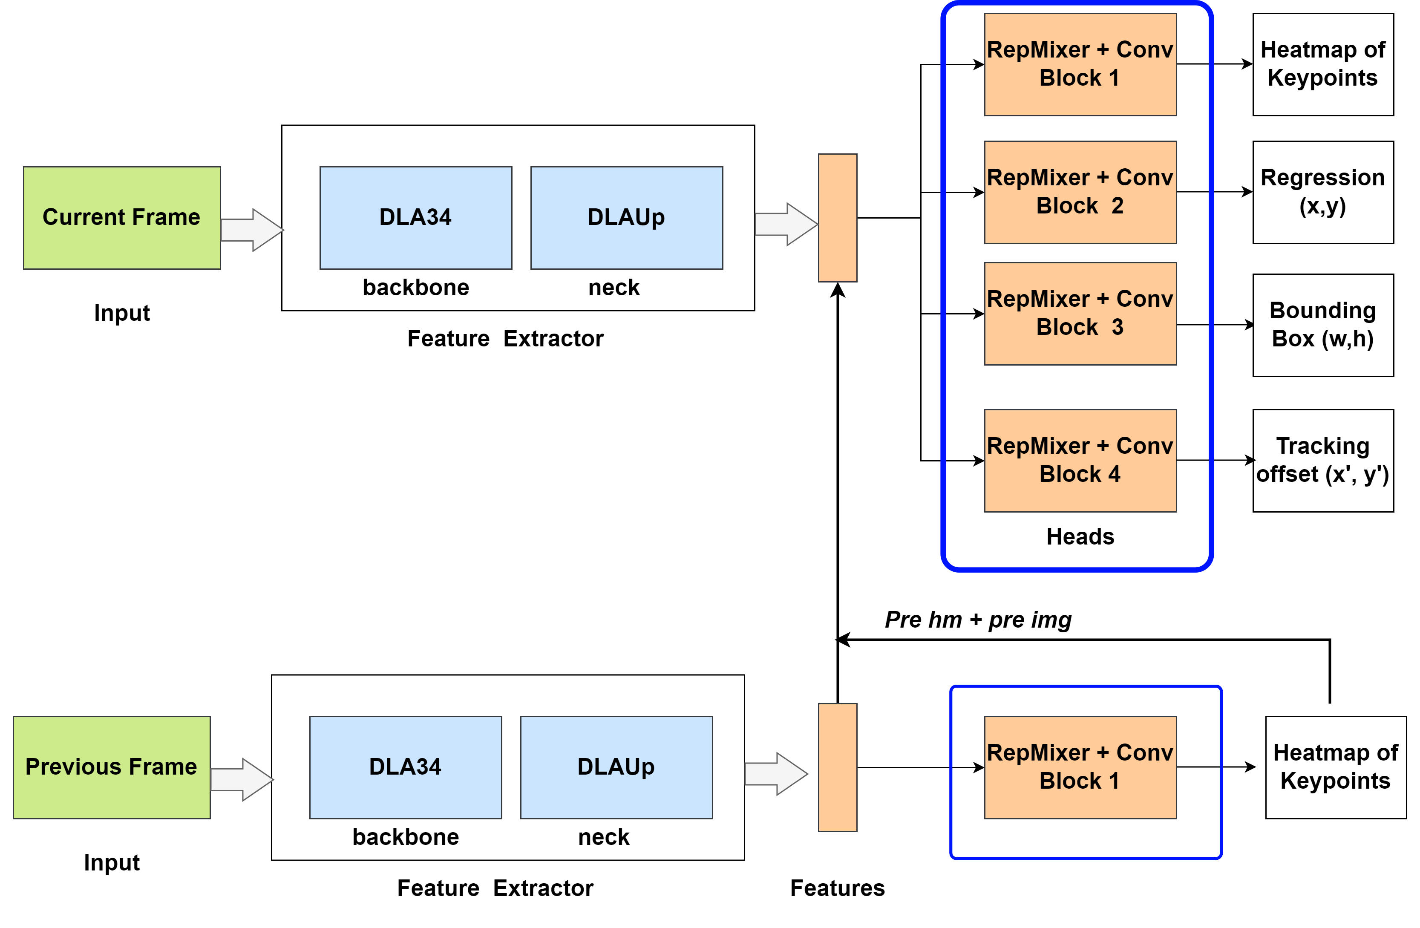
Introducing Attention through Mixers in the Head Network
Replaced the several conv blocks in the head network with one RepMixer blocks followed by one conv block.
Fig:17 CenterTrack Architecture with RepMixer hybrid head.
19
Dheeraj Master’s Thesis on Object Tracking

Slide 20
Introducing Attention through Mixers
Conclusion from the results
Slight decrease in performance, as we replaced several conv blocks from head with a single RepMixer head.
Improvement in the overall model efficiency.
Head Networks | Class | MOTA (↑) | FP (↓) | FN (↓) | IDSW(↓)
Conv Blocks | Car Pedestrian | 83.02 61.49 | 933 397 | 906 1317 | 23 13
RepMixer + Conv Block | Car Pedestrian | 80.48 40.93 | 1165 661 | 959 1350 | 17 15
Head Network | FLOPS (↓) | Model Size (↓) | Infer Time (↓)
Conv Blocks | 105.56 G | 19.91 M | 28.4 ms
RepMixer + Conv Blocks | 70.33 G | 19.2 M | 27.5 ms
Table 4: Tracking accuracy comparison of CenterTrack with Hybrid Head Network.
Table 5: Efficiency evaluation of CenterTrack with Hybrid Head Network.
20
Dheeraj Master’s Thesis on Object Tracking

Slide 21
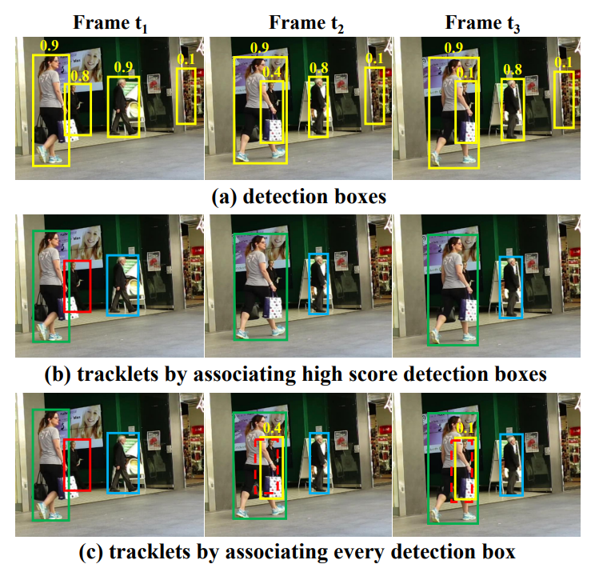
Analysing the Unused Tracks and Detections in the Tracker Module
Leveraging unused tracklets and unmatched detections in the tracker module.
Formulated by ByteTrack Tracker.
Tracker Module
Considers only those objects with confidence score > T.
Low score objects (T< 0.5) are ignored as false positives.
Modified Tracker Module:
Step 1: Associate high score objects with tracklets.
Step 2: Match the low score objects (0.25-0.5) with unmatched tracklets in the current frame.
Fig:18 ByteTrack inference on partially occluded object [11].
21
Dheeraj Master’s Thesis on Object Tracking

Slide 22
Unused Tracks and Detections in the Tracker Module
No change in the CenterTrack model architecture.
Requires an additional function to associate the low score detections with unmatched tracklets.
Model size, Params, FLOPS remains the same.
Conclusion
False Negatives have reduced
Able to recover true objects having low scores.
False Positives have reduced
Able to continue the tracks for longer, reducing the chance of detecting unwanted objects present near true positives.
Tracker | Class | MOTA (↑) | FP (↓) | FN (↓) | IDSW(↓)
Original | Car Pedestrian | 83.02 61.49 | 933 397 | 906 1317 | 23 13
Improved | Car Pedestrian | 83.99 40.93 | 916 388 | 852 1242 | 17 11
Table 6: Tracking accuracy comparison of CenterTrack with improved tracker module.
22
Dheeraj Master’s Thesis on Object Tracking

Slide 23
Conclusion
Networks with iterative and hierarchical connections in the backbone tend to produce better features than deeper networks alone.
A good combination of backbone and neck networks is crucial for extracting high-quality feature representations.
MLP Mixers can be considered as a alternative for convolutional blocks, offering comparable performance with improved efficiency.
Detection boxes with low scores can be useful for identifying and recovering objects belonging to the target class.
23
Dheeraj Master’s Thesis on Object Tracking

Slide 24
References
https://medium.com/intro-to-artificial-intelligence/motion-planning-module-in-autonomous-vehicle-mission-planner-671b2155dec1
https://stackoverflow.com/questions/18802498/how-to-identify-a-car-after-performing-canny-edge-in-a-still-image-opencv
https://www.google.com/url?sa=i&url=https%3A%2F%2Fwww.researchgate.net%2Ffigure%2FArchitecture-of-Deep-SORT-Simple-online-and-real-time-tracking-with-deep-association_fig2_353256407
https://arxiv.org/abs/2004.01177
https://paperswithcode.com/sota/multiple-object-tracking-on-kitti-tracking
https://openaccess.thecvf.com/content_cvpr_2018/papers/Yu_Deep_Layer_Aggregation_CVPR_2018_paper.pdf
https://images.app.goo.gl/YabGd7ctuGH16Qoe8
https://arxiv.org/abs/1908.07919
https://arxiv.org/abs/2111.11418
https://arxiv.org/pdf/2303.14189.pdf
https://arxiv.org/abs/2110.06864
24
Dheeraj Master’s Thesis on Object Tracking

Slide 25
Thank you! Questions?
25
Dheeraj Master’s Thesis on Object Tracking

Slide 26
Additional slides for my reference

Slide 27
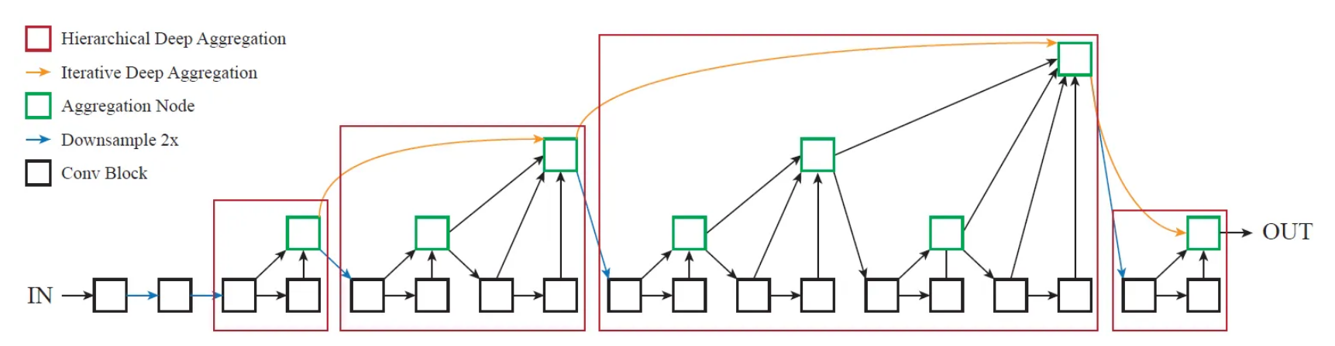
Deep Layer Aggregation (DLA) Backbone
Aggregates features from multiple layers for better representation.
Implements hierarchical learning across stages for multi-scale feature extraction.
Uses pooling for downsampling and convtranspose2d for upsampling.
Captures both spatial and semantic features effectively.
Fig 10: Deep Layer Aggregation [6].
27
Dheeraj Master’s Thesis on Object Tracking

Slide 28
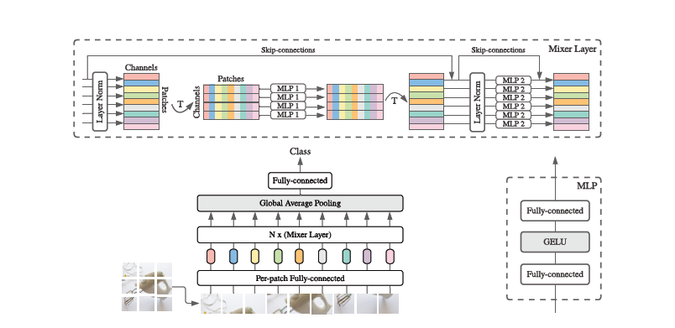
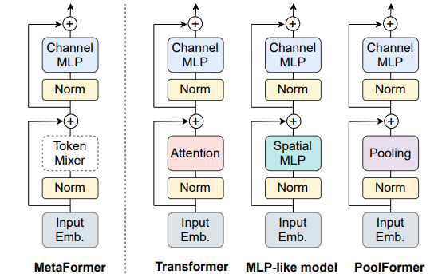
Additional slides for my reference

